Slide 1
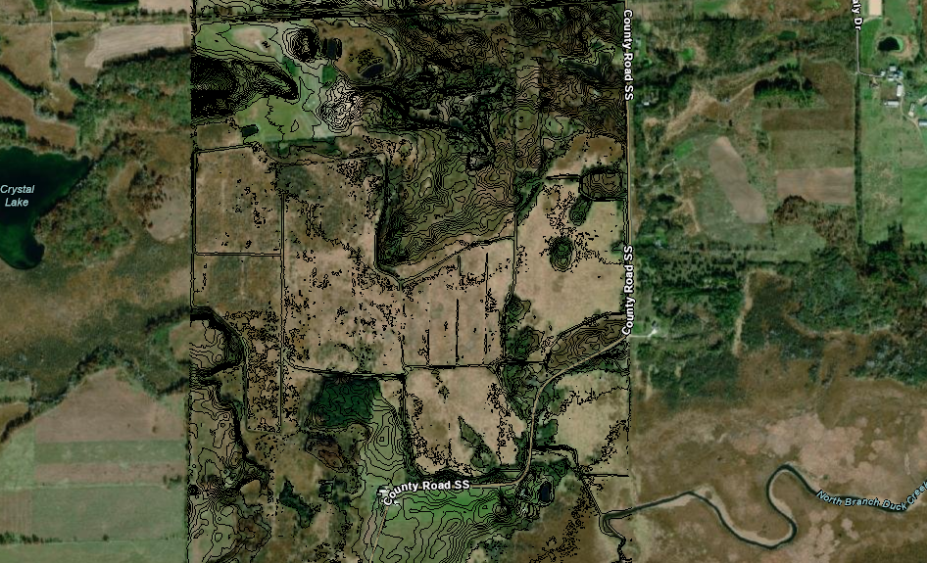
Jeffrey Manthey
???
Brian Pierson
Willing partner
Flow
PL
Welch Prairie LLC ???

Slide 2
A
C
B

Slide 3
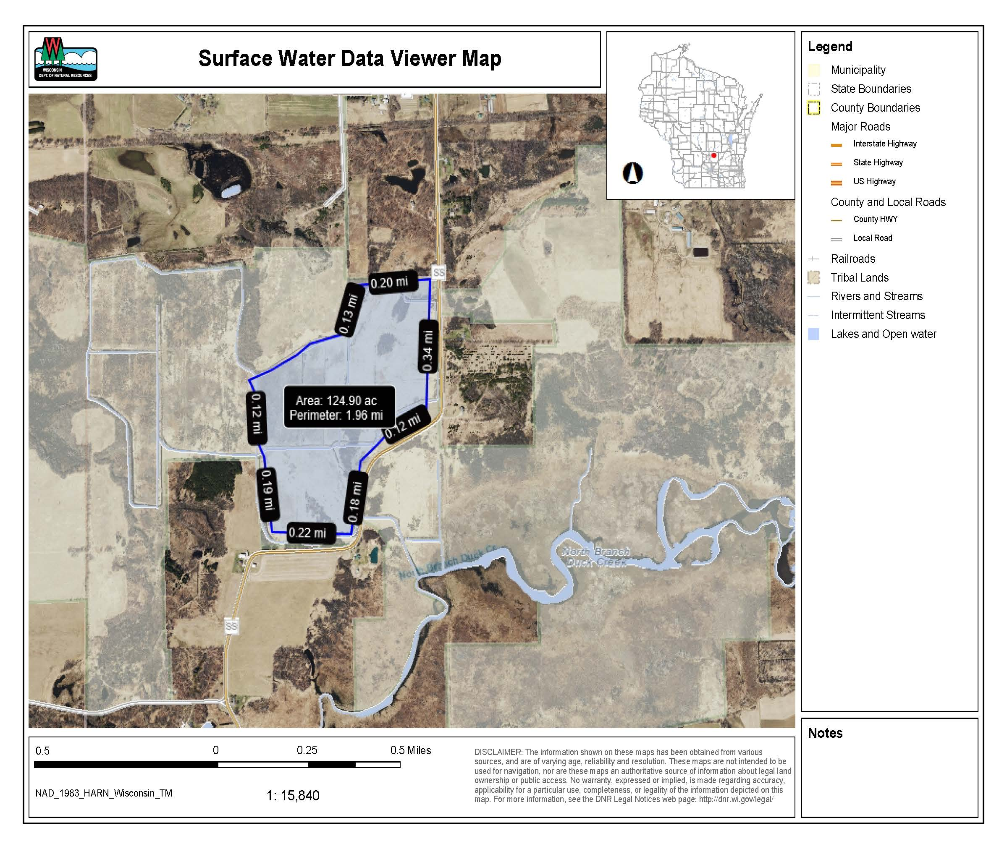

Slide 4
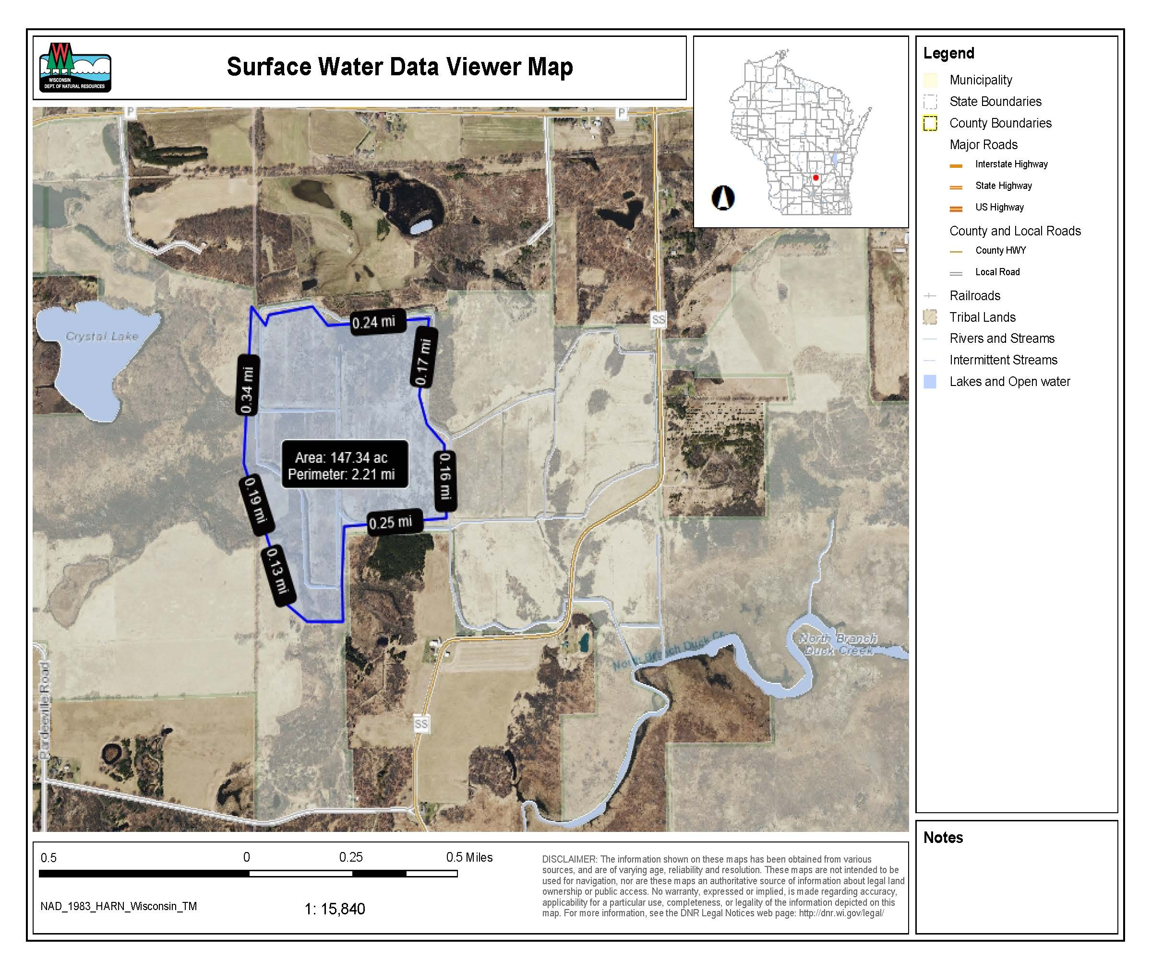

Slide 5
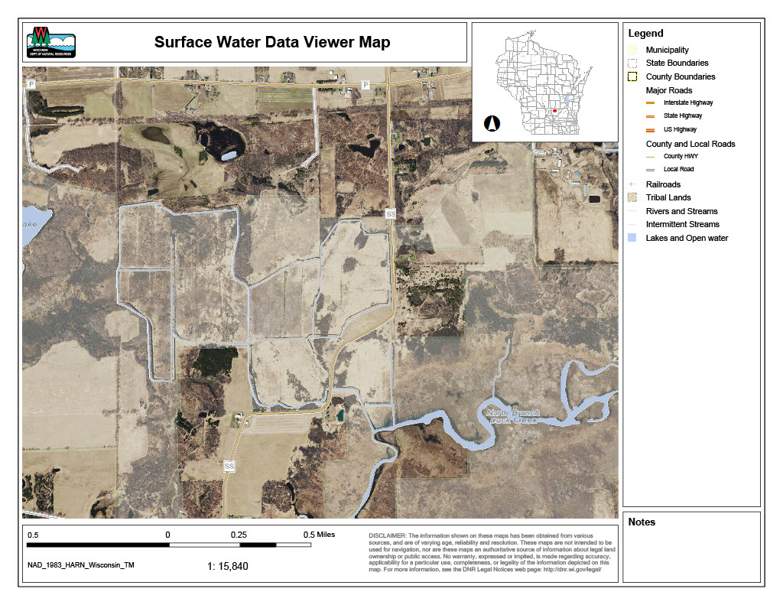
8
4
2
5
3
4
3
5
2
7
1
6
Ditch plug
Water control
Eyebrow berm
Scrape, spoil source
1

Slide 6
Ditch plug
Water control
Eyebrow berm
Scrape, spoil source
8
4
2
5
4
3
2
3
1
5
7
1
6

Slide 7
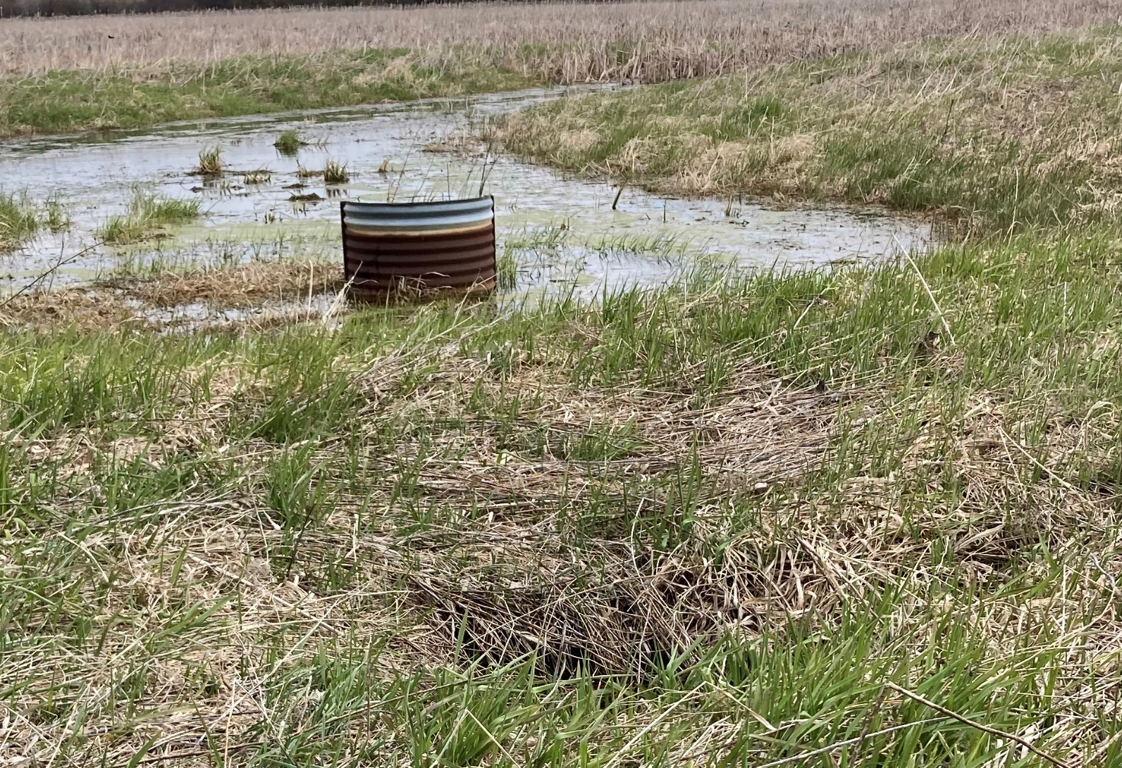
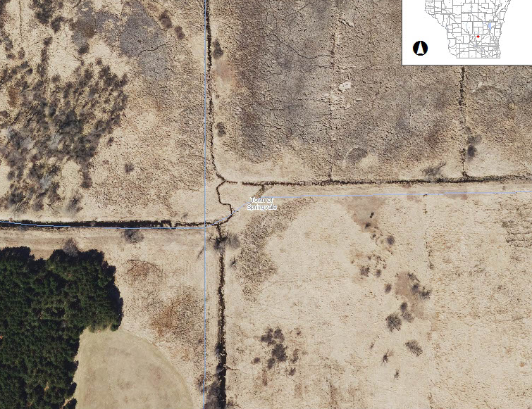
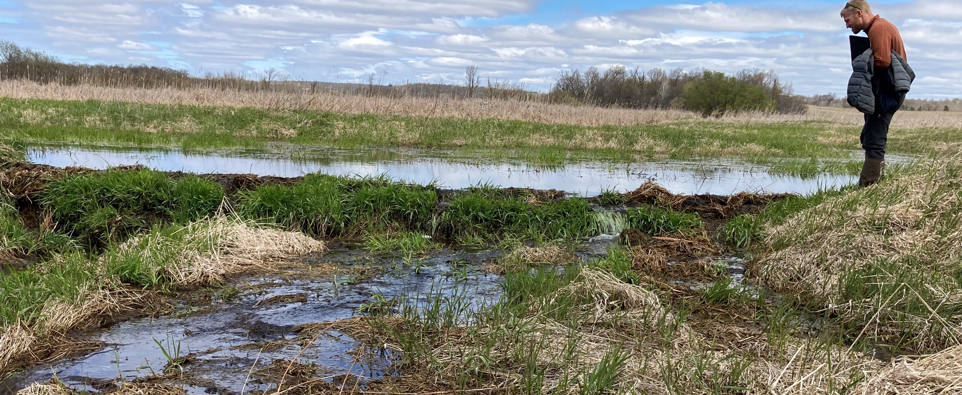
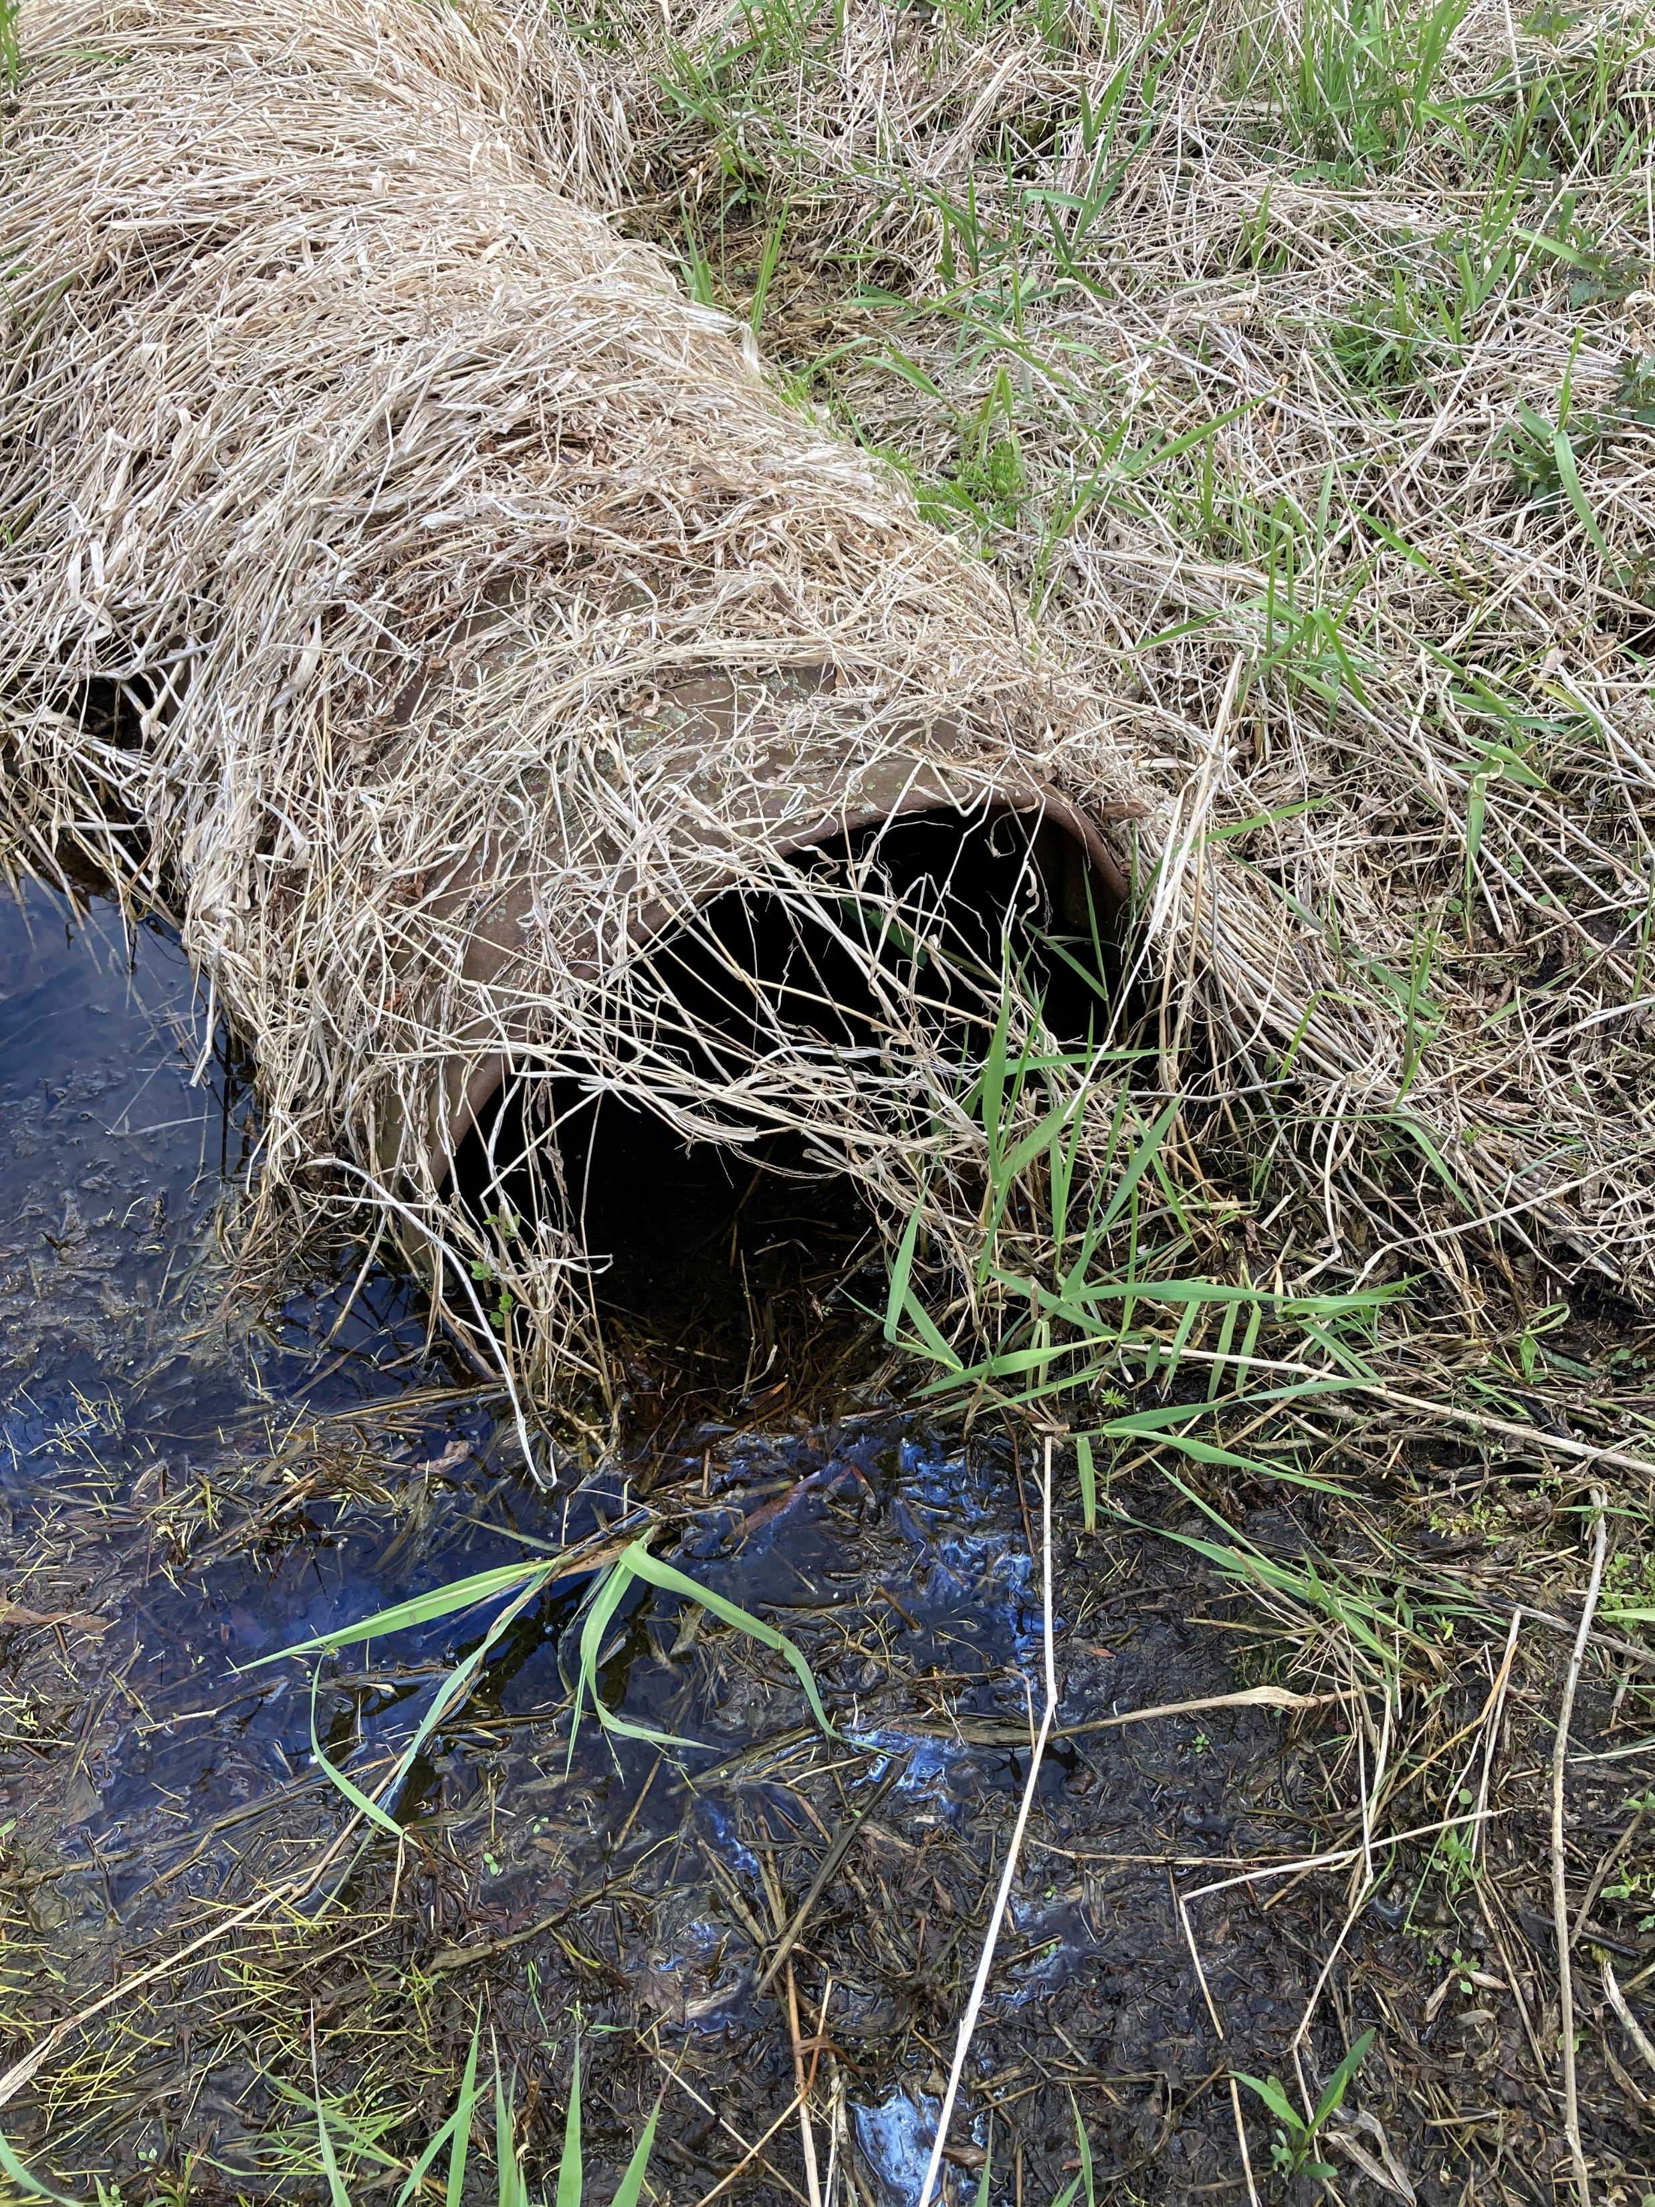
Location of existing non-functioning infrastructure
Beaver dam

